Slide 1
Progress Report
Yida Zhang
9/3/2024

Slide 2
Outline
Dataset Generation

Slide 3
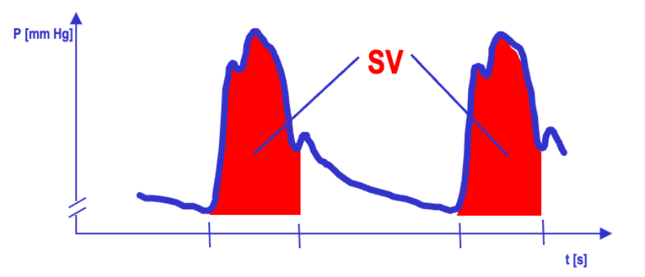
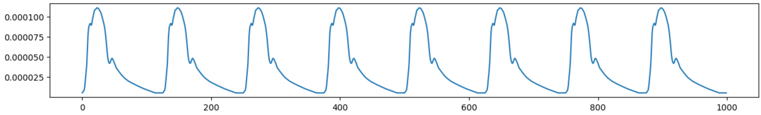
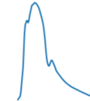
Dataset Generation
Description: Step 1: simulate this signal in the figure above and use the shadowed area size as SV, and calculate MAP = HR*SV*TPR as the label, where TPR = c (constant). Generate a baseline data set
Real Signal
Simulated Signal
Implementation:
Generate random MAP (50,100), HR (50,100) and constant TPR (0.01)
According to MAP = HR*SV*TPR, adjust the SV by stretching and compressing its height and width.

Slide 4
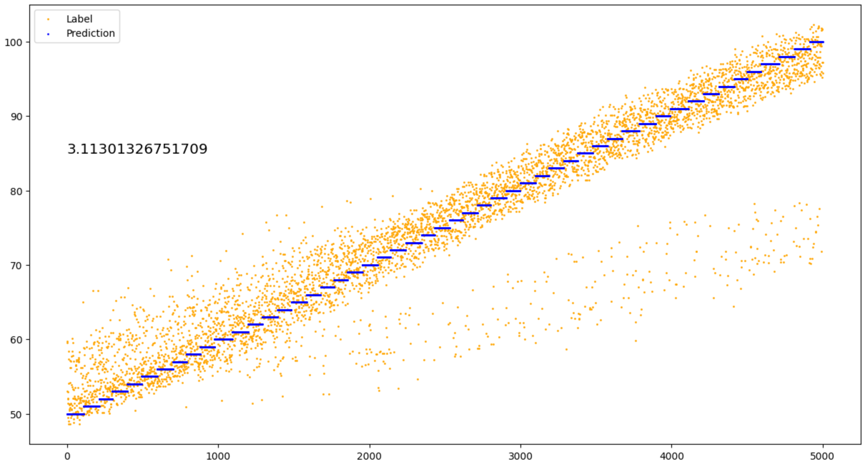
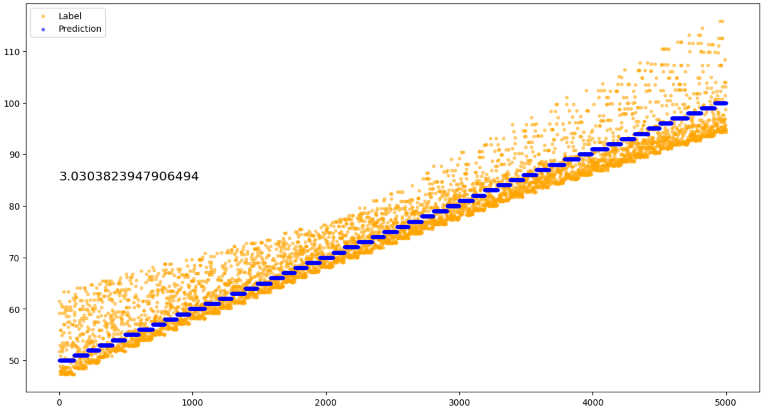
Result of Step 1
Result of DL
Result of DSP

Slide 5
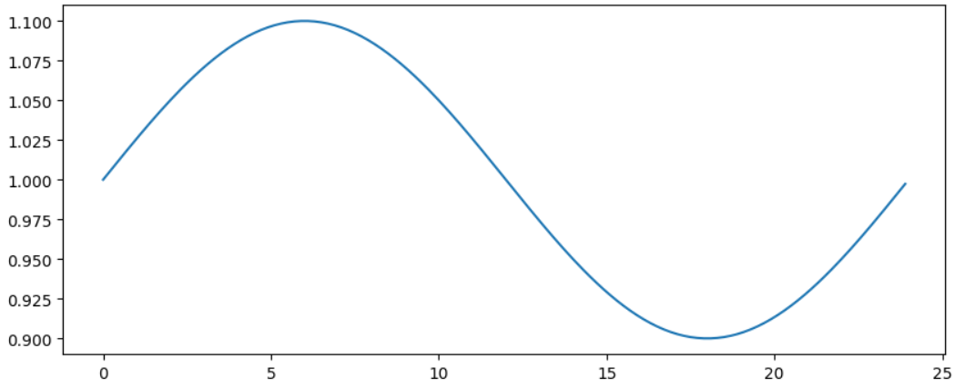
Dataset Generation
Description: Step 2: relax TPR = c + noise, further relax TPC = c(t) + noise which changes over the 24-hour cycle; generate the corresponding two datasets.
TPR = c + noise = 0.01 + random.uniform(-noise, noise), where noise = 0.001/0.005 (10%/50%)
TPR = c(t) + noise = 0.01 * F(t, amp) + random.uniform(-noise, noise), where amp = 0.1/0.2/0.5
F(t,0.1)

Slide 6
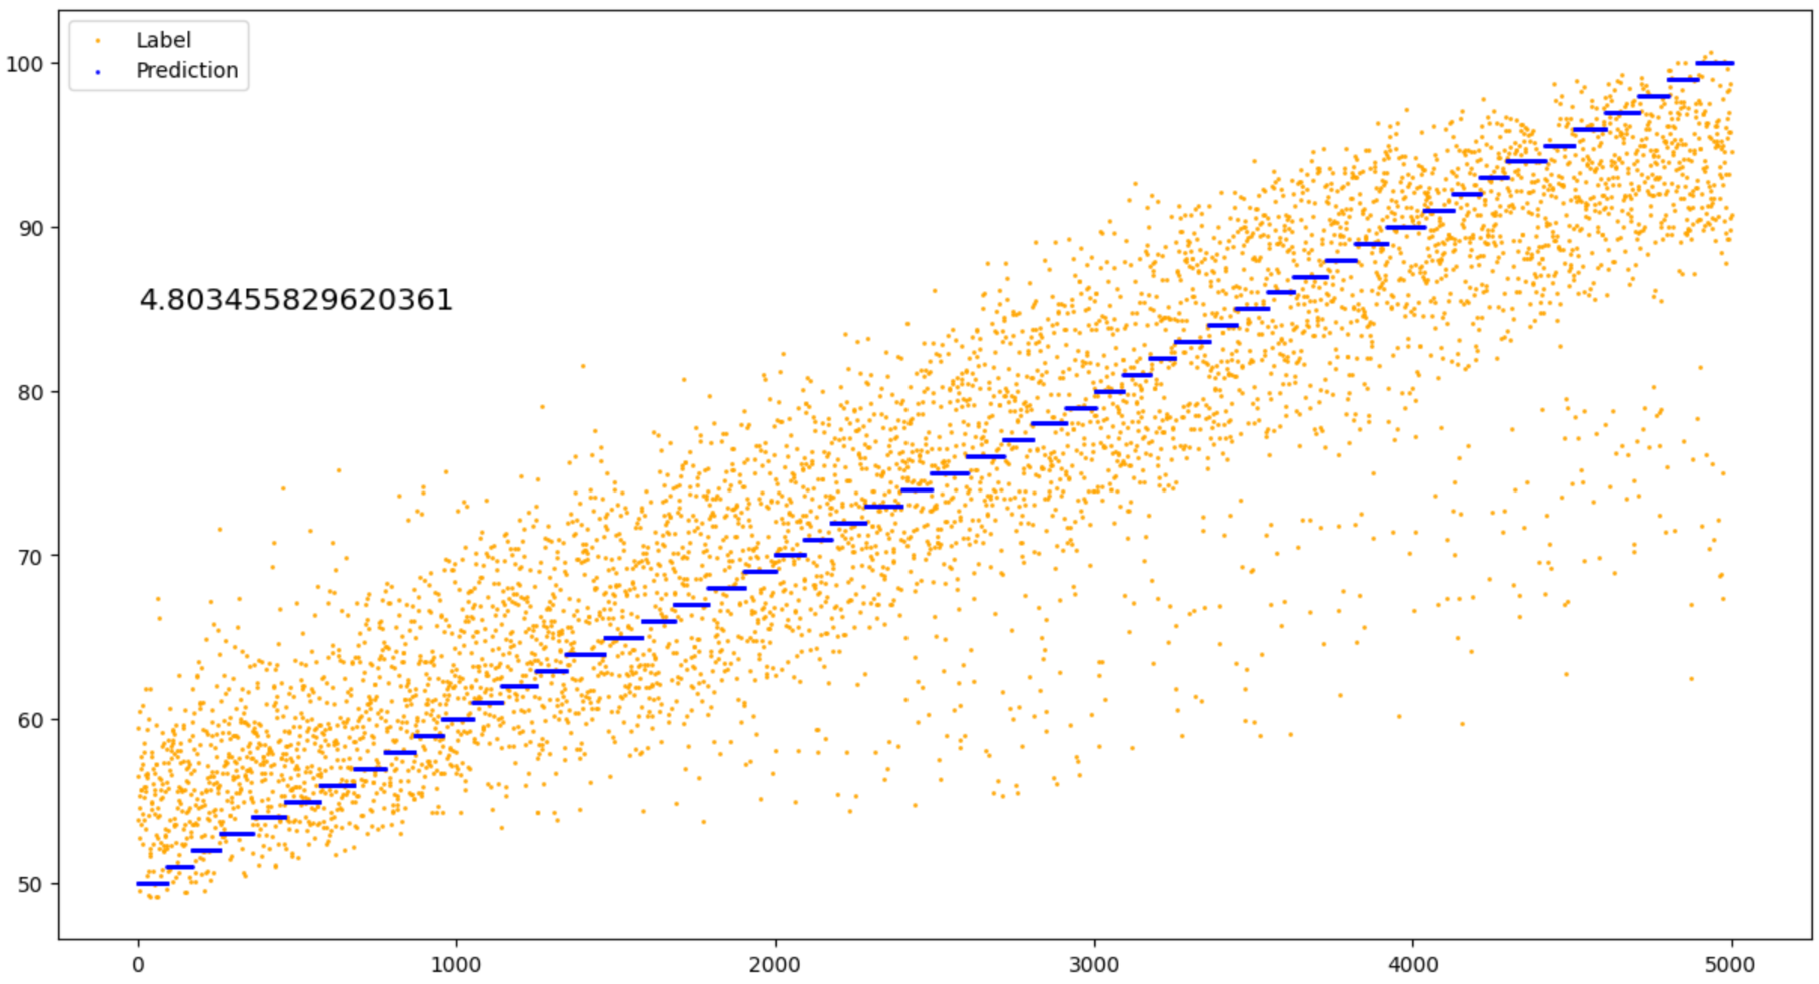
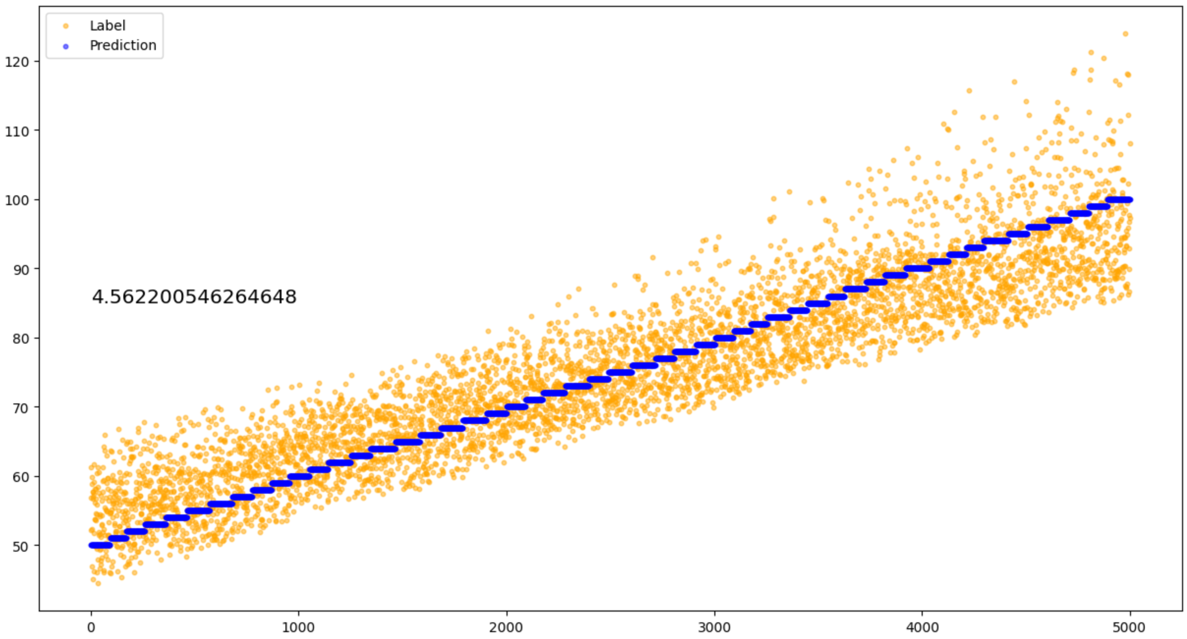
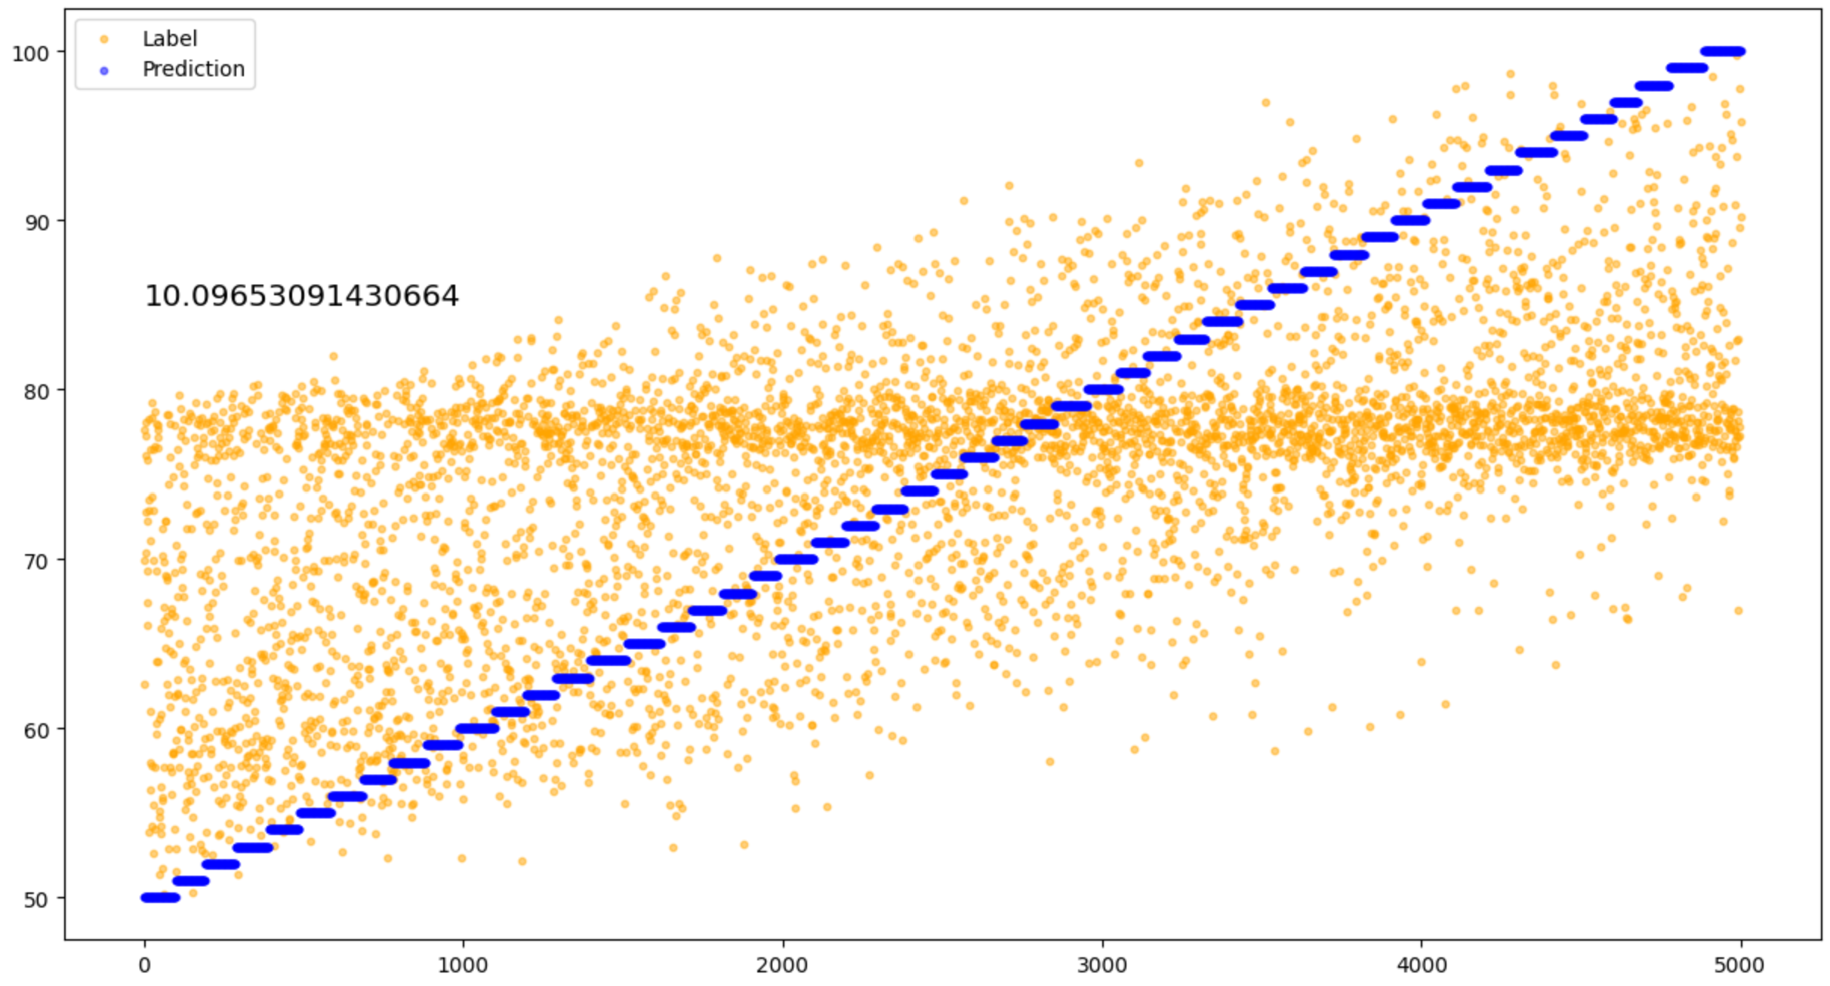
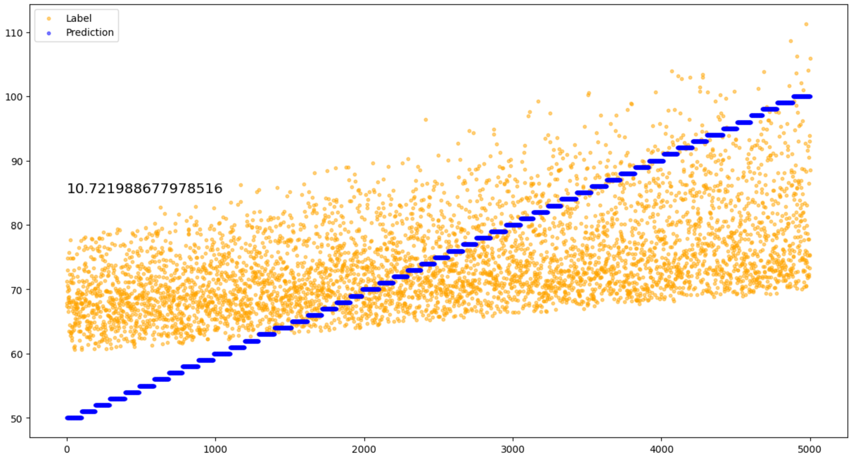
Result of Step 2 (TPR = c + noise = = 0.01 + random.uniform(-noise, noise), )
Result of DL 10% noise
Result of DSP 10% noise
Result of DL 50% noise
Result of DSP 50% noise

Slide 7
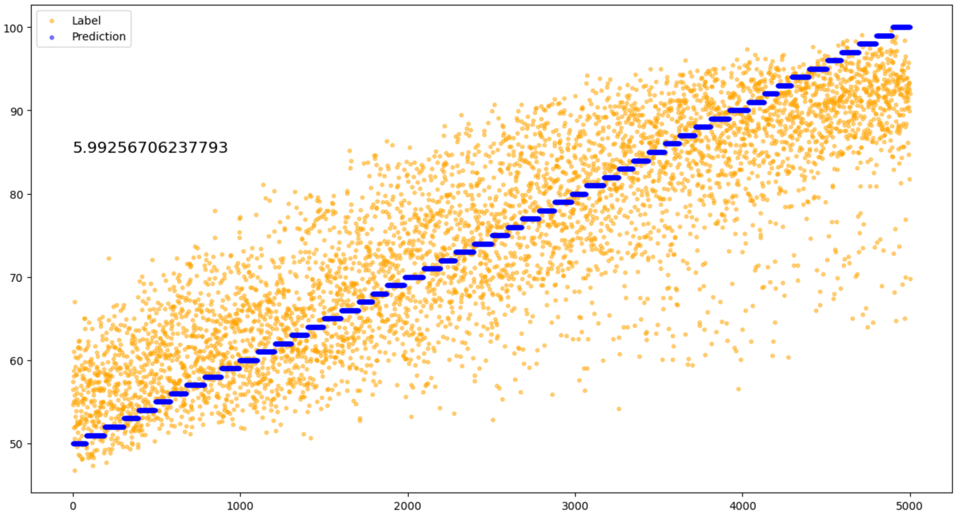
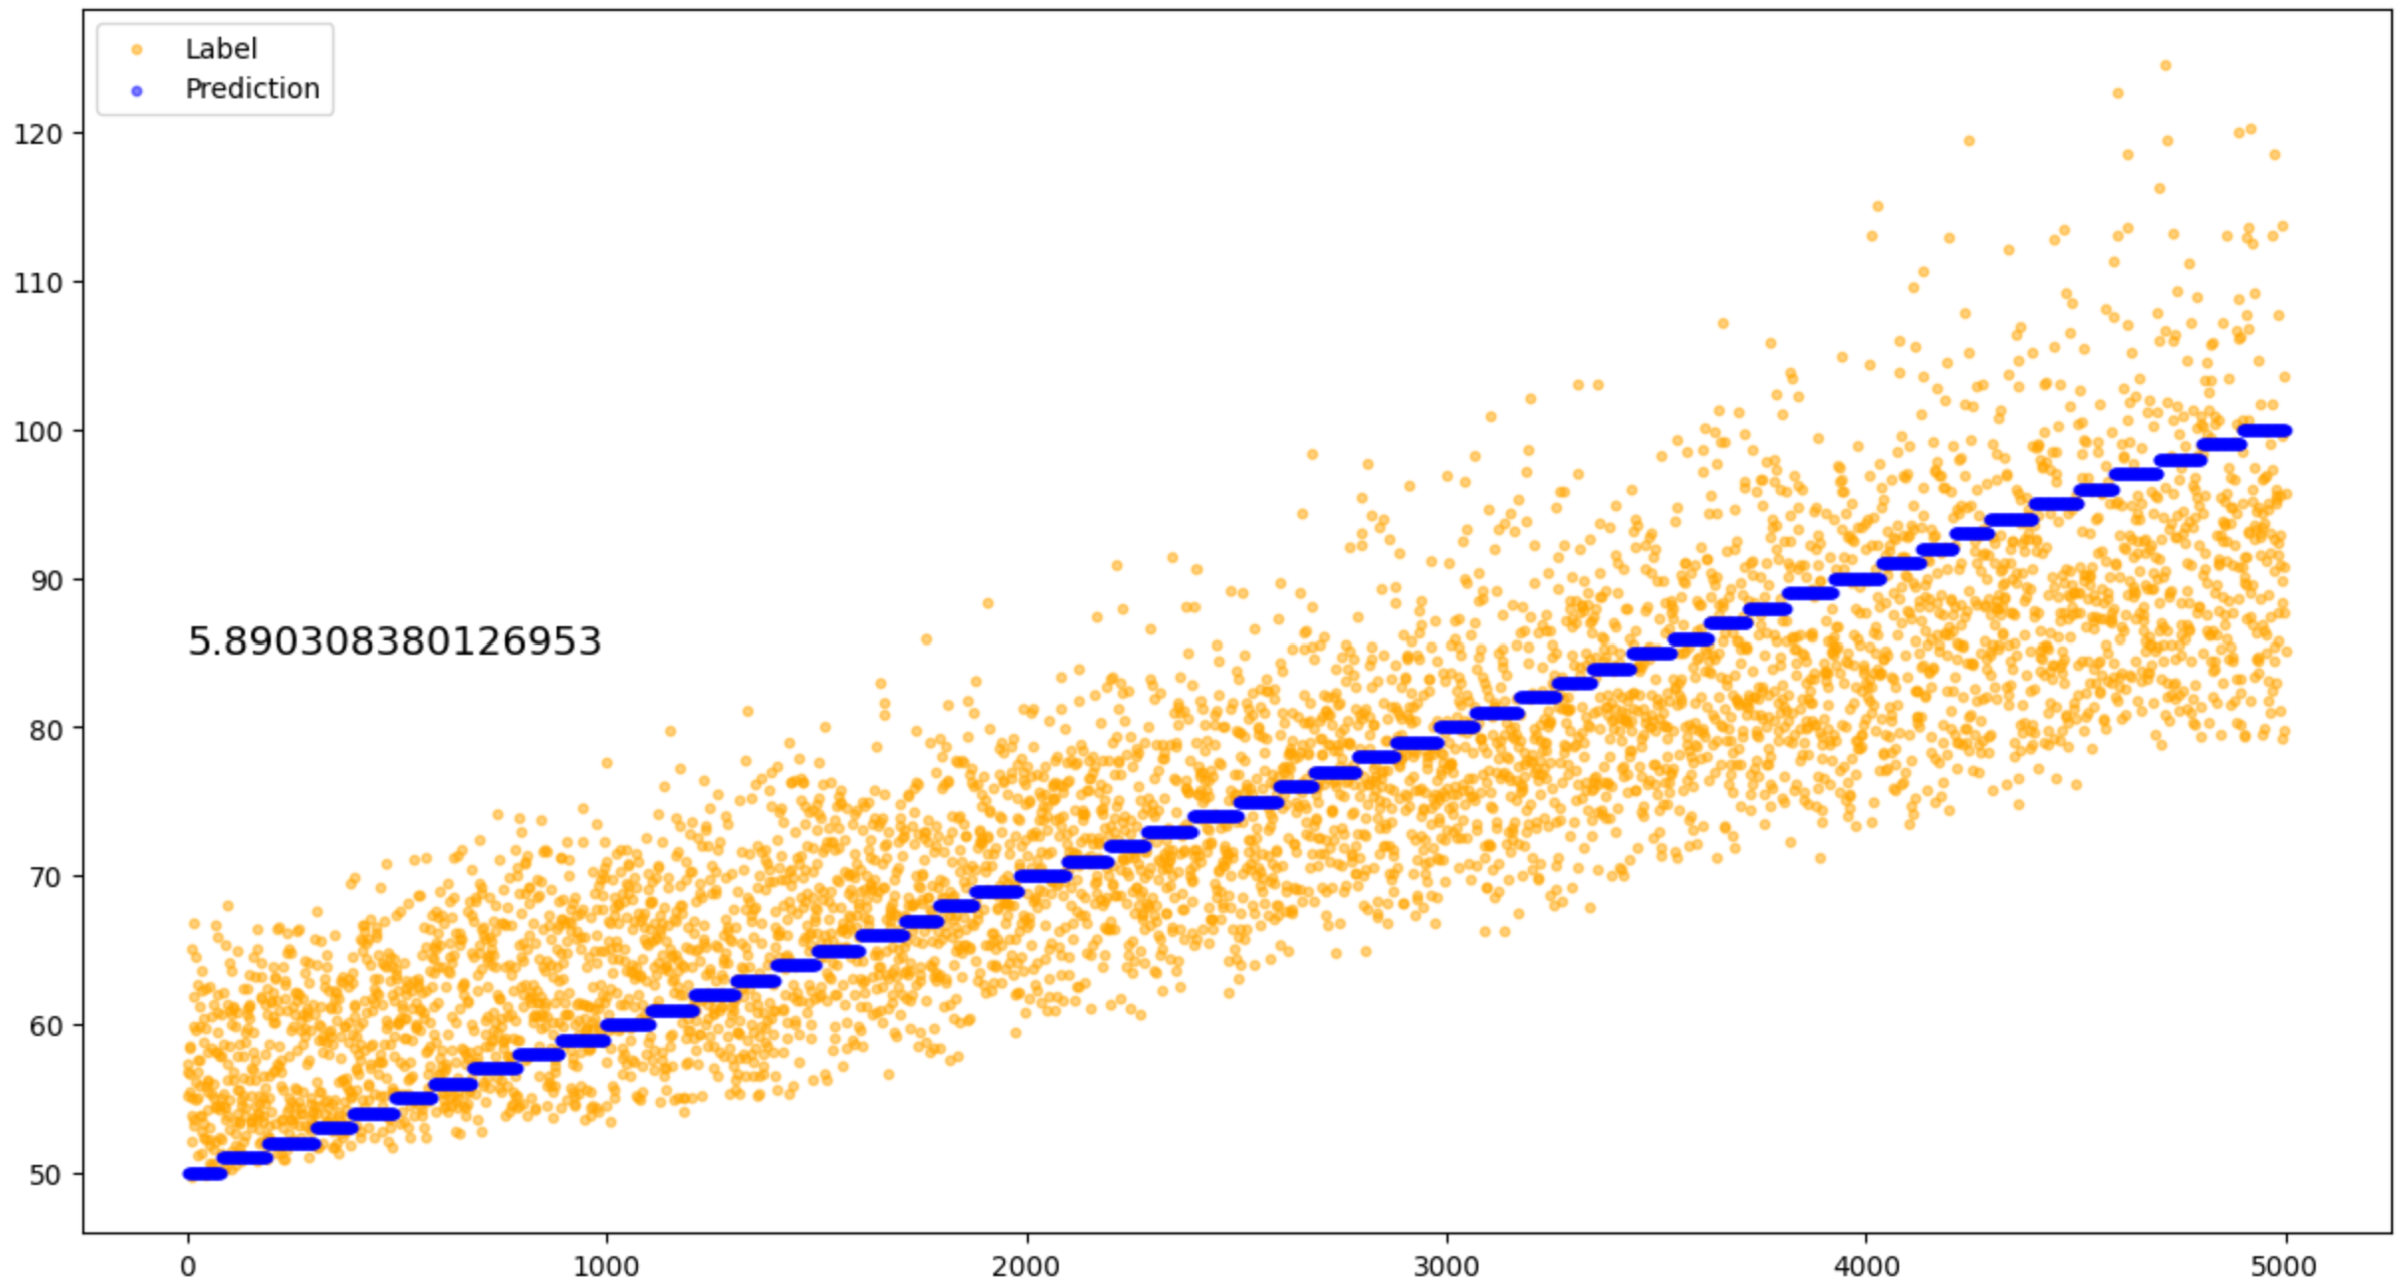
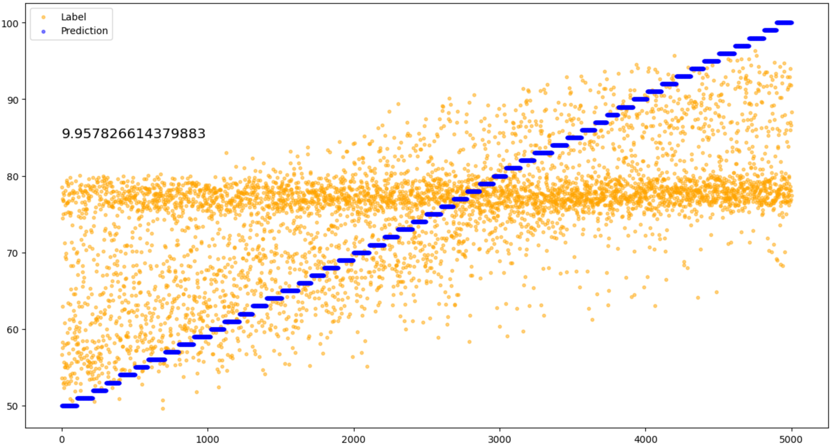
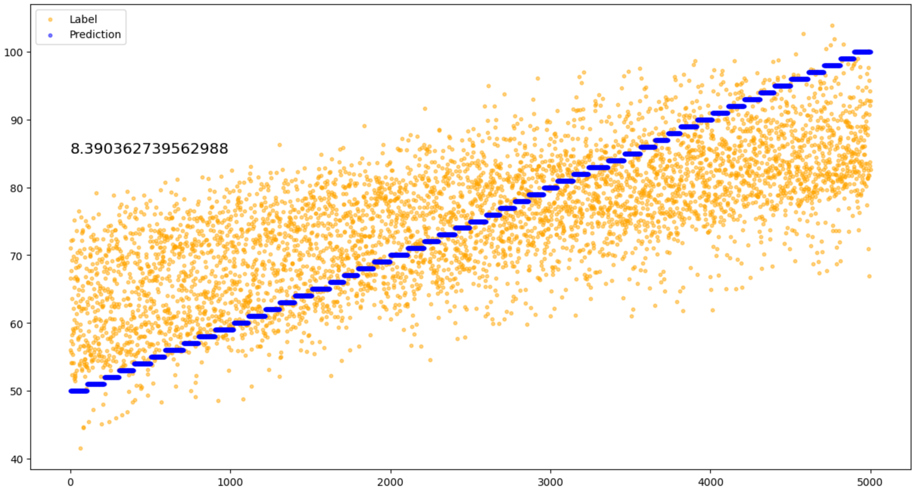
Result of Step 2 (TPR = c(t) + noise = 0.01 * F(t, amp) + random.uniform(-noise, noise))
Result of DL 10% noise, amp = 0.1
Result of DSP 10% noise, amp = 0.1
Result of DL 10% noise, amp = 0.5
Result of DL 10% noise, amp = 0.5

Slide 8
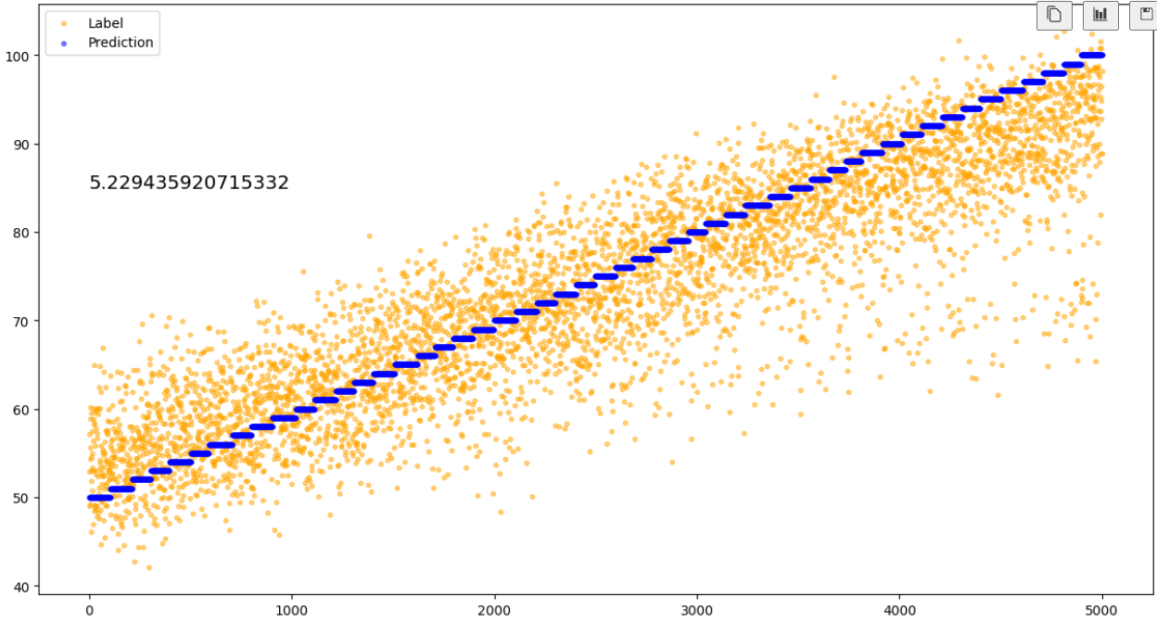
Result of Step 2 (TPR = c(t) + noise = 0.01 * F(t, amp) + random.uniform(-noise, noise))
Description: If the input of DL is not (1000,) time series only, but added with the time information, the result will be better a lot.
Result of DL 10% noise, amp = 0.5, without time information
Result of DL 10% noise, amp = 0.5, with time information

Slide 9
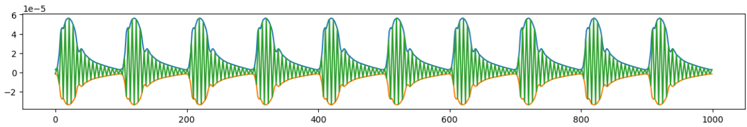
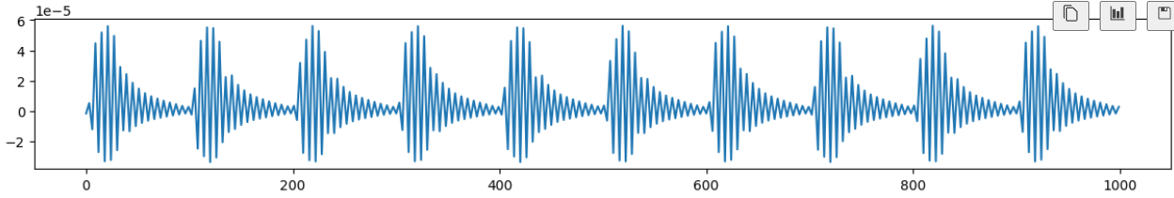
Dataset Generation
Description: Step 3: generate a combination of two motherlet waves for each heartbeat, such that the envelope of the combination shows two peaks as the figure above; then similarly repeat step 1 and step 2 to generate 3 datasets: c, c+noise, c(t)+noise.

Slide 10
Thanks

